Slide 1
Inheritance

Slide 2
Types of Inheritance
Single Inheritance
Multilevel Inheritance
Hierarchical Inheritance
Multiple Inheritance
Hybrid Inheritance

Slide 3
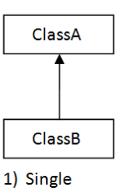
Single Inheritance
When a class inherits another class, it is known as a single inheritance.

Slide 4
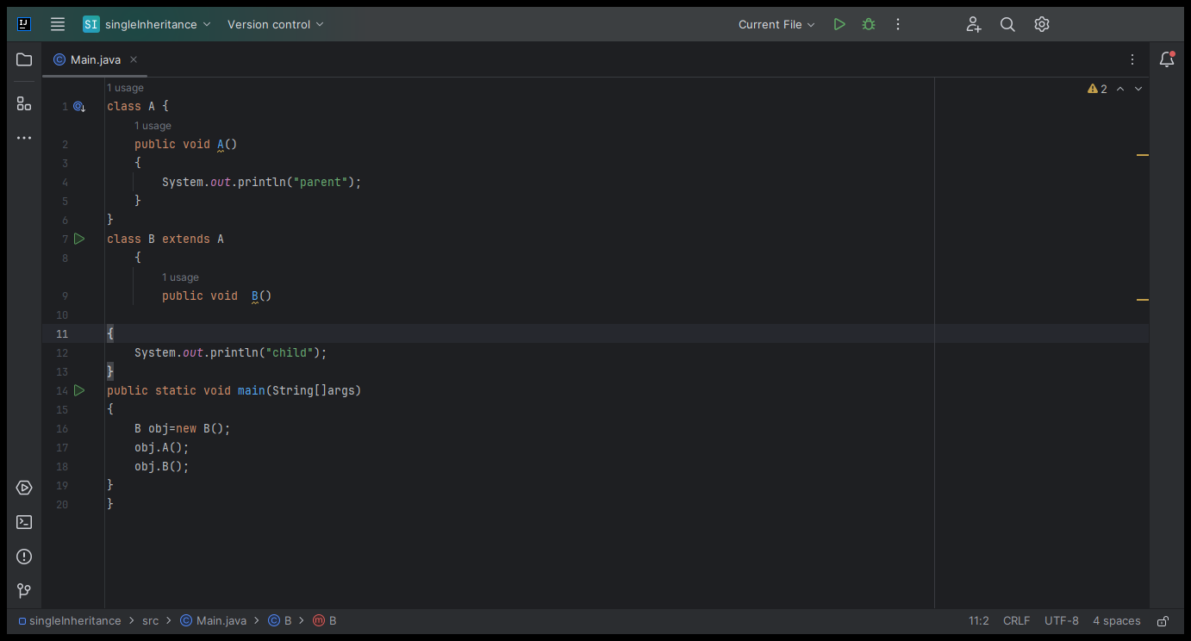

Slide 5
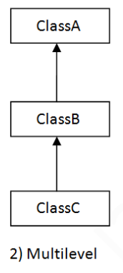
Multilevel Inheritance
When there is a chain of inheritance, it is
known as multilevel inheritance.

Slide 6
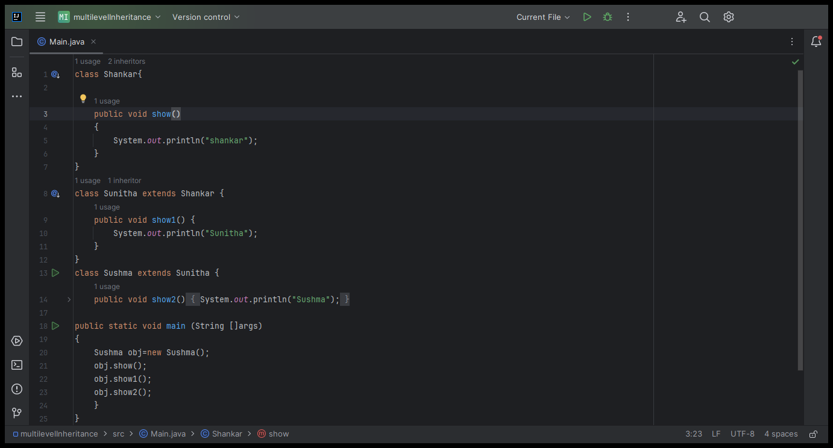

Slide 7
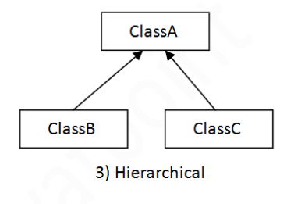
Hierarchical Inheritance
When two or more classes
inherits a single class,
it is known as
hierarchical inheritance.

Slide 8
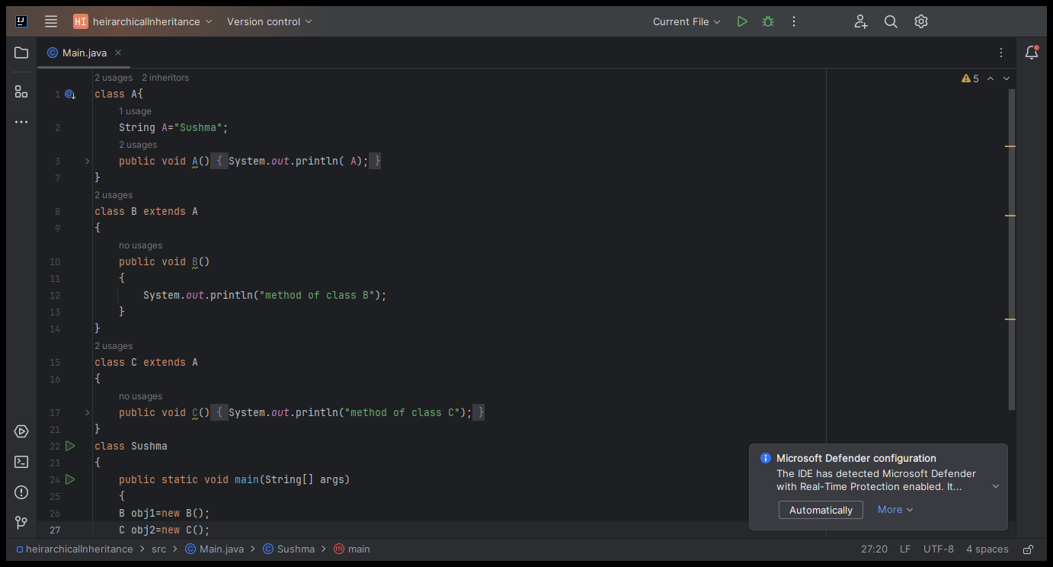

Slide 9
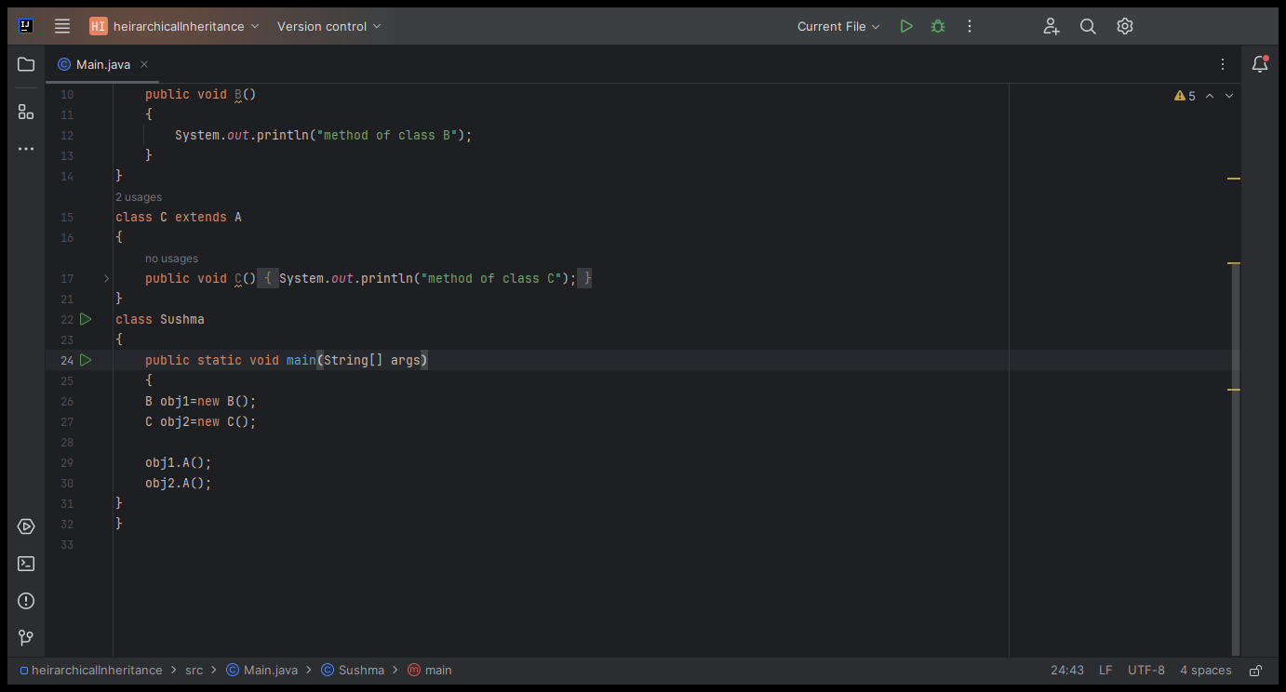

Slide 10
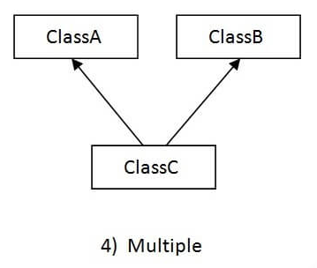
Multiple Inheritance
When a single class inherits
from two more classes ,
is known as
multiple inheritance.

Slide 11
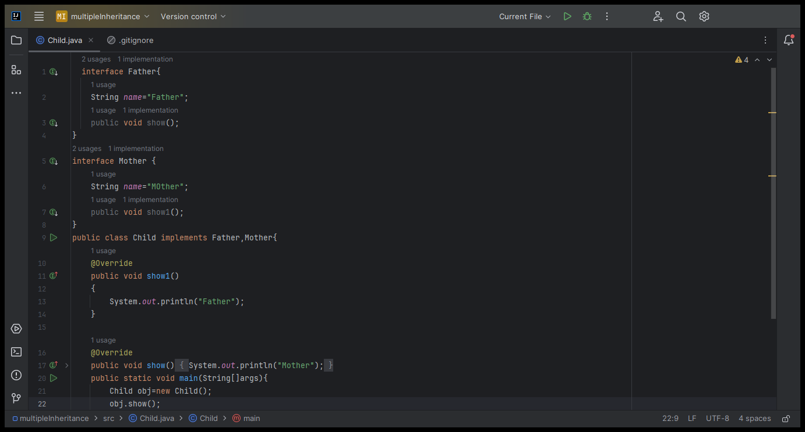

Slide 12
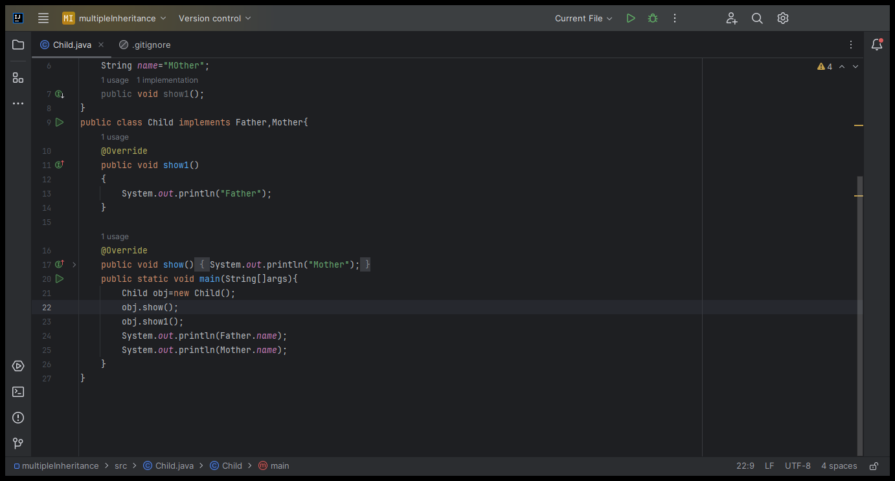

Slide 13
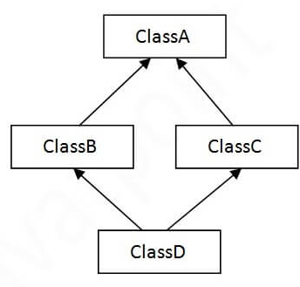
Hybrid Inheritance

Slide 14
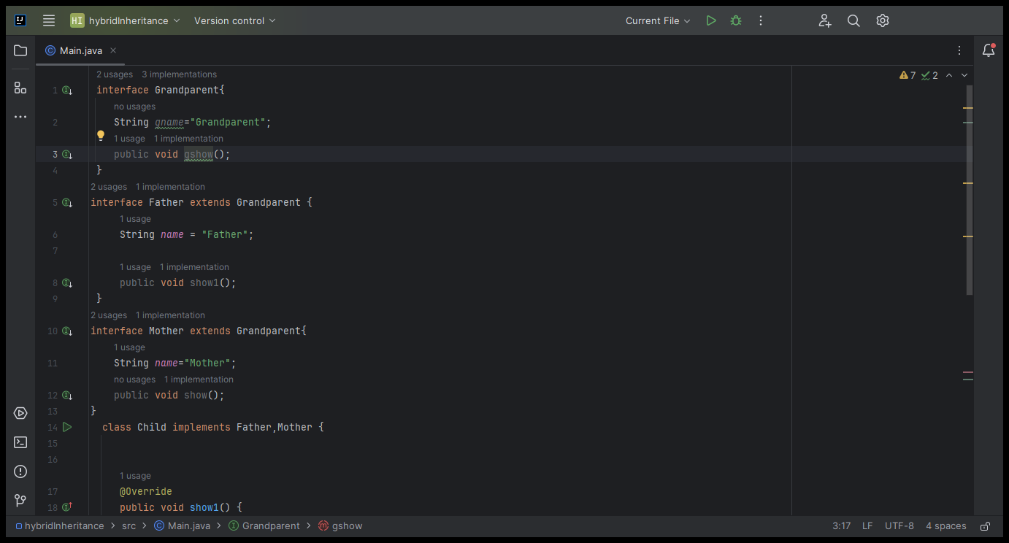

Slide 15
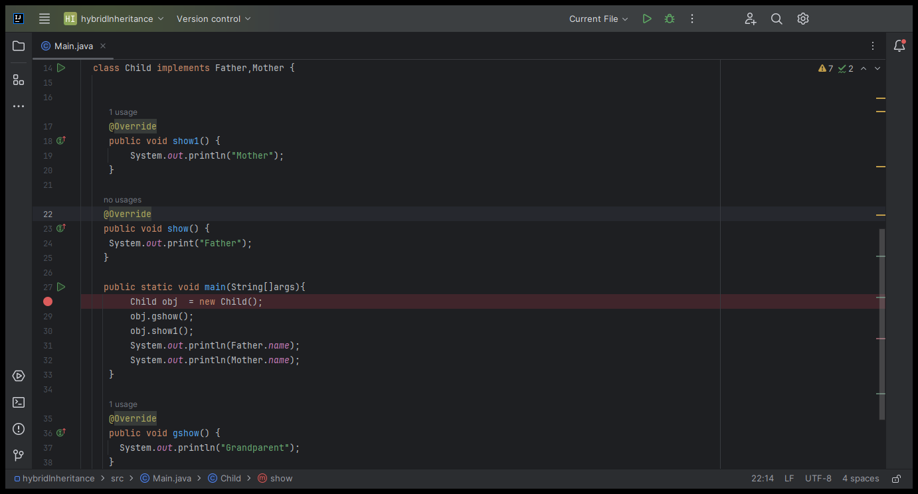

Slide 16
Why multiple inheritance is not supported in java?
To reduce the complexity and simplify the language, multiple inheritance is not supported in java.
By the help of Interface we achieve the multiple inheritance.

Slide 17
Interface
An interface in Java is a blueprint of a class. It has static Variables and abstract methods.
By interface, we can support the functionality of multiple inheritance and abstraction.
There can be only abstract methods in the Java interface.

Slide 18
Syntax:
Interface InterfaceName{
Static variables;
Abstract methods;
}

Slide 19
Abstract Methods
A method declared using the abstract keyword and does not have a definition (implementation) is called an abstract method.
An abstract method do not have a body (implementation), they just have a method signature (declaration).
As the abstract methods just have the signature, it needs to have semicolon (;) at the end.
Syntax: abstract return_type method_name( [ argument-list ] );
Example: abstract String show(String Name);

Slide 20
Why use Java interface?
There are mainly three reasons to use interface. They are given below.
It is used to achieve abstraction.
By interface, we can support the functionality of multiple inheritance.
It can be used to achieve loose coupling.

Slide 21
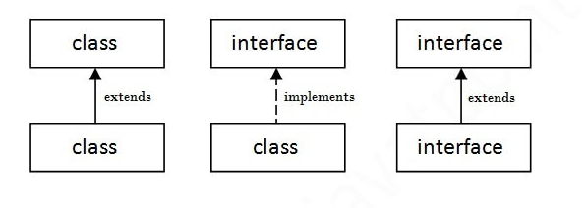
Rules

